Slide 1

NREGA ANALYSIS
Mission : NREGA seeks to enhance the livelihood security of the households in rural areas of the country by providing at least 100 days of guaranteed wage employment in every financial year to every household whose adult members volunteer to do unskilled manual work
By: Aubrey Mubonani

Slide 2
PROBLEM STATEMENT
EVALUATATON OF THE
EFFECTIVENESS OF THE PROGRAM
EVALUATATON OF THE
REGIONAL DISPARITIES IN THE PROGRAM
BUDGET UTILIZATION AND FACTORS AFFECTING COMPLETION

Slide 3
NREGA ANALYSIS DASHBOARD
Power BI Desktop
All
All
34 736 5.43K
269,233,343
TOTAL WORKERS
175,479,159
TOTAL ACTIVE WORKERS
65.18%
Active Workers %
155,746,806
JOB CARDS ISSUED
97,048,349
ACTIVE JOB CARDS
62.31%
Active Jobs %
2,207,060,000
APPROVED BUDGET
13,055,054
ONGOING WORKS
3,710,809
COMPLETED WORKS
28.42%
Job Completion %
TOTAL WORKERS and ACTIVE WORKERS by STATE
TOTAL WORKERS ACTIVE WORKERS
30M
25M
20M
15M
10M
5M
0M
STATE
TOTAL WORKERS and ACTIVE WORKERS
BIHAR
ASSAM
ODISHA
GUJARAT
KERALA
PUNJAB
TRIPURA
SIKKIM
LADAKH
GOA
HARYANA
MANIPUR
MIZORAM
RAJASTHAN
KARNATAKA
TELANGANA
JHARKHAND
MEGHALAYA
NAGALAND
WEST BENGAL
TAMIL NADU
CHHATTISGARH
UTTARAKHAND
PUDUCHERRY
LAKSHADWEEP
MAHARASHTRA
UTTAR PRADESH
MADHYA PRADESH
ANDHRA PRADESH
HIMACHAL PRADESH
ARUNACHAL PRADESH
DN HAVELI AND DD
JAMMU AND KASHMIR
ANDAMAN AND NICOBAR

Slide 4
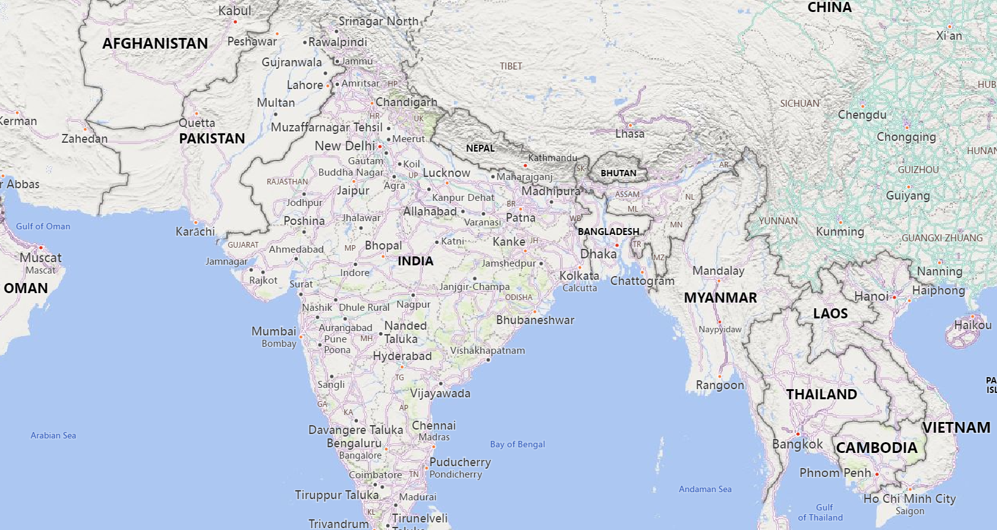
















ACTIVE WORKERS by STATE
Power BI Desktop

Slide 5

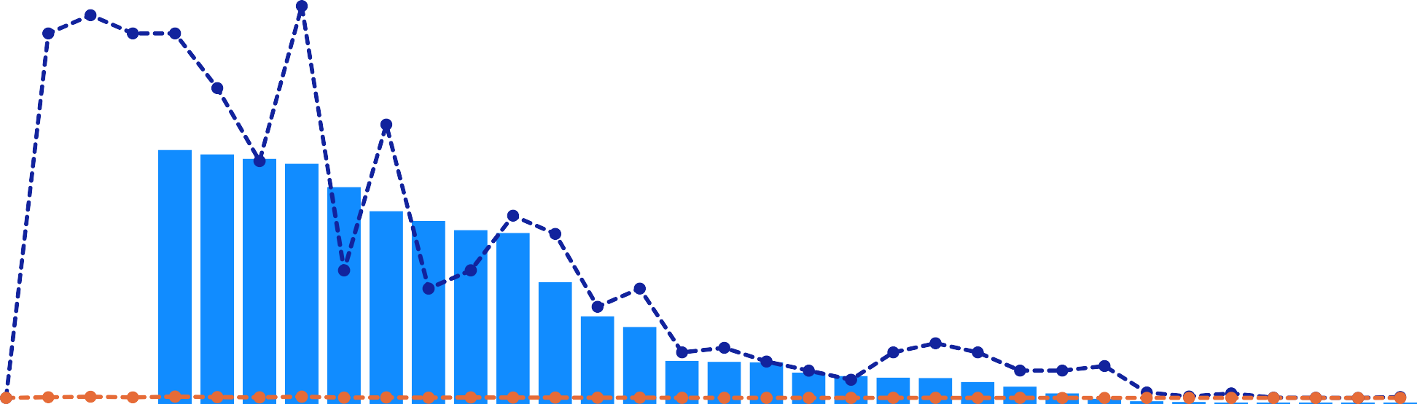
BUDGET ANALYSIS
Power BI Desktop
All
All
2bn
5.47M 4.02M
113.13K
1.34M
ACTIVE WORKERS, APPROVED BUDGET and TOTAL EXPENDITURE by STATE
ACTIVE WORKERS APPROVED BUDGET TOTAL EXPENDITURE
20M
APPROVED BUDGET and TOTAL EXPENDITURE
0.2bn
15M
ACTIVE WORKERS
10M
0.1bn
5M
0M
APPROVED BUDGET
0.0bn
BIHAR
ODISHA
ASSAM
GUJARAT
KERALA
PUNJAB
HARYANA
TRIPURA
MANIPUR
MIZORAM
SIKKIM
LADAKH
GOA
RAJASTHAN
TAMIL NADU
KARNATAKA
TELANGANA
JHARKHAND
MEGHALAYA
NAGALAND
PUDUCHERRY
WEST BENGAL
UTTAR PRADESH
MAHARASHTRA
CHHATTISGARH
UTTARAKHAND
LAKSHADWEEP
MADHYA PRADESH
ANDHRA PRADESH
HIMACHAL PRADESH
ARUNACHAL PRADESH
DN HAVELI AND DD
JAMMU AND KASHMIR
ANDAMAN AND NICOBAR
STATE

Slide 6
46M 63M
Power BI Desktop
SOCIAL INCLUSIVE ANALYSIS
SC ACTIVE WORKERS VS ST ACTIVE WORKERS
396K 35M
29M
29M (45.1…)
SC ACTIVE ST ACTIVE
ST workers against active workers and SC workers against active workers by STATE
ST workers against active workers SC workers against active workers
6M
35M (54.86%)
4M
SC PERSONS DAY VS ST PERSONS DAYS
2M
280M (46.57%)
SC person…
ST person…
0M
ODISHA
ASSAM
BIHAR
KERALA
SIKKIM
GOA
PUNJAB
GUJARAT
TRIPURA
MANIPUR
LADAKH
HARYANA
MADHYA …
NAGALAND
MIZORAM
RAJASTHAN
TELANGANA
KARNATAKA
321M (53.43%)
JHARKHAND
MEGHALAYA
TAMIL NADU
PUDUCHERRY
CHHATTISGARH
WEST BENGAL
UTTARAKHAND
LAKSHADWEEP
MAHARASHTRA
ANDHRA PRADESH
UTTAR PRADESH
DN HAVELI AND DD
ARUNACHAL PRADESH
JAMMU AND KASHMIR
HIMACHAL PRADESH
ANDAMAN AND NICOBAR
STATE

Slide 7
JOB EFFICIENCY ANALYSIS BY STATE
Power BI Desktop
Sum of Number of Completed Works and Sum of Number of Ongoing Works by STATE
Sum of Number of Completed Works Sum of Number of Ongoing Works
2M
1M
0M
Sum of Number of Completed Works
BIHAR
ASSAM
KERALA
ODISHA
TRIPURA
GUJARAT
PUNJAB
LADAKH
HARYANA
SIKKIM
MANIPUR
GOA
KARNATAKA
RAJASTHAN
TELANGANA
MIZORAM
NAGALAND
JHARKHAND
TAMIL NADU
WEST BENGAL
MEGHALAYA
PUDUCHERRY
LAKSHADWEEP
CHHATTISGARH
UTTARAKHAND
MADHYA PRAD…
UTTAR PRADESH
ANDHRA PRADESH
MAHARASHTRA
HIMACHAL PRADESH
ARUNACHAL PRADESH
DN HAVELI AND DD
JAMMU AND KASHMIR
ANDAMAN AND NICO…
STATE
TOP 5 STATES BY JOB EFFICIENCY
LEAST 5 STATES BY JOB EFFICIENCY
100%
100%
LADAKH
128.91%
LAKSHADWEEP
3.14%
TAMIL NADU
121.33%
GOA
1.89%
MIZORAM
107.96%
WEST BENGAL
1.35%
JHARKHAND
59.56%
MANIPUR
0.44%
MADHYA PRADESH
51.31%
DN HAVELI AND DD
0.00%
39.8%
0%

Slide 8
KEY FINDINGS AND RECOMMENDATIONS
65
KEY FNDIDINGS
RECOMMENDATIONS
NREGA Program is active in 34 states and 736 districts
65% of the NREGA total employees are active
62% of all job cards issued are active
Job completion on ongoing works is at 28%
They is some budget mismatch for some states with highest active workers but under budgeted in West Bengal
Total expenditure (5.47m) is relatively lower (0.3%) than the labour budget of 2 billion
Despite Ladakh and Mizoram state having fewer active workers they’re in employees top 5 on Job Efficiency
Increase Employee Activation Rates-Targeted Training Programs
Enhance Job Card Usage: Awareness Campaigns: Conduct awareness campaigns to educate potential beneficiaries about the benefits and usage of job cards. Ensure that all eligible individuals are aware of how to obtain and utilize their job cards effectively.
Improve Job Completion Rates: Project Management Training: Provide training in project management to local coordinators and supervisors to help them better manage and complete ongoing works
Address Budget Mismatches: Reallocate Budget: Conduct a thorough review of budget allocations and reallocate funds to ensure that states with the highest number of active workers, such as West Bengal, receive adequate funding.
Leverage Successful Models: Replicate Successful Practices: Analysing the successful models from states like Ladakh and Mizoram, which despite having fewer active workers, are among the top in job efficiency. Replicate their best practices in other states to improve overall efficiency
Optimize Expenditure: Efficiency Improvements: Identify and implement efficiency improvements in the use of allocated funds to ensure that a larger proportion of the budget is effectively utilized for labour and project completion.

